Slide 1
Water resources
Water is an indispensable natural resource on this earth on which all life depends. About 97% of the earth's surface is covered by water and most of the animals and plants have 60-65% water in their body.
WATER IS AN UNIQUE RESOURCE
Water is characterized by certain unique features which make it a marvelous resource:
1). It exist as a liquid over a wide range of temperature i.e. from 0°C to 100°C.
2) It has the highest specific heat, due to which it warms up and cools down very slowly.
3) It has a high latent heat of vaporization.
4) It is an excellent solvent for several nutrients. Thus, it can serve as a very good carrier of nutrients, including oxygen, which are essential for life.

Slide 2
HYDROLOGICAL CYCLE
The hydrological cycle continuously purifies, recycles and distributes fresh water.
The water we use keeps on cycling endlessly through the environment, which we call as hydrological cycle.
The water from various moist and wet surface evaporates and falls again on the earth in the form of rain or snow and passes through living organisms and ultimately returns to the oceans.
Every year about 1.4 inch thick layer of water evaporates from the oceans, more than 90% of which return to the oceans by hydrological cycle.
Solar energy drives the water cycle by evaporating it from various water bodies, which subsequently return through rainfall or snow.

Slide 3
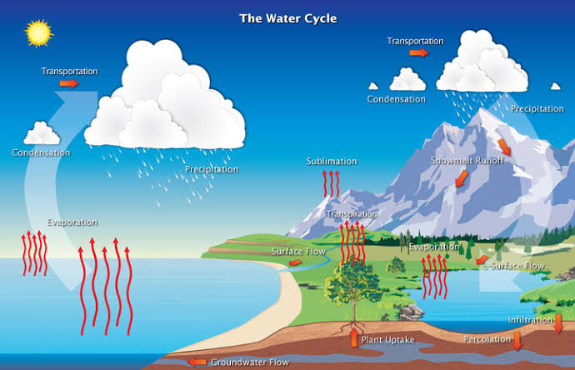
Hydrological Cycle

Slide 4
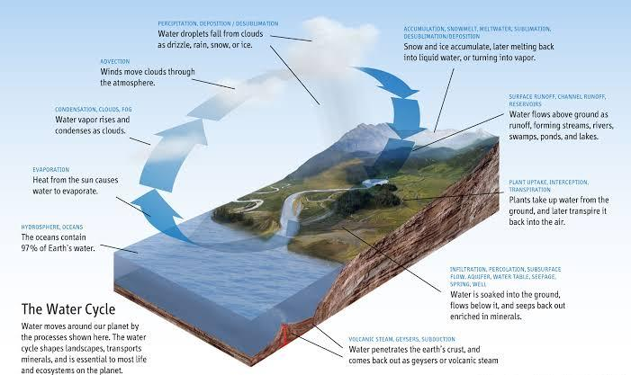
Water cycle

Slide 5
Plant too play a very important role by absorbing the groundwater from the soil and releasing it into the atmosphere by the process of transpiration.
Global distribution of water resources is quite uneven depending upon several geographic factors. Tropical rain forest areas receive maximum rainfall while the major world deserts occur in zones of dry, descending air (20°to 40° N and S) and receive very little rainfall.

Slide 6
Global distribution of water
Although water is abundant on this earth, yet it is very precious.
Out of the total water reserves of the world, about 97.5% is salty water (marine) and only 2.5% is fresh water.
Even this small fraction of fresh water is not available to us as most of it is locked up in polar ice caps (1.98%) and just 1.2% is readily available to us in the form of groundwater and surface water (river and lakes), water in the atmosphere and living organisms.
OCEANS:- Oceans are ultimate sinks for all type of water. About 97.5% of total water is present in oceans. Salt content of ocean is about 3.5%. Sea water is not fit for human consumption and other anthropogenic activities without desalination.

Slide 7
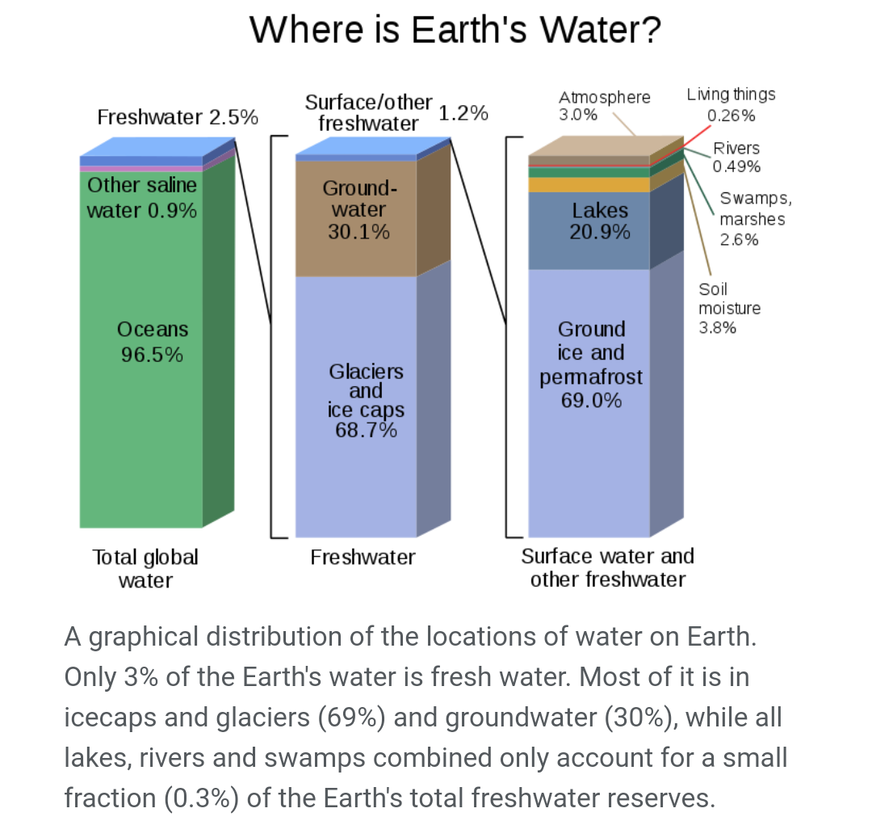
Global distribution of water

Slide 8
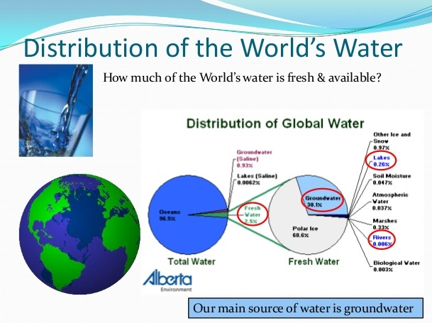

Slide 9
Glaciers and ice: A major part of available approximately 2.5% of fresh water is locked up into glaciers and ice caps. These occur at high altitude or high latitude.
Antarctic glacier contains approximately 85% of all the world’s ice. About 10% is made by Greenland ice-sheet and Arctic ice-sheet. Rest 5% is in the form of snow on mountain peaks.
So we have to use this precious fresh water very judiciously and wisely. As per UN estimate (2005), it is said that 2/3rd of the world population will be suffering from acute water shortage by 2024.

Slide 10
Water use and over-exploitation
Water is absolutely essential for life. Most of the life processes take place in water contained in the body.
Uptake of nutrients, their distribution in the body, regulation of temperature, and removal of wastes are all mediated through water.
Human beings depend on water for almost every developmental activity. Water is use for drinking, irrigation, transportation, washing and waste disposal for industries and used as a coolant for thermal power plants.
Water shapes the earth surface and regulates our climate.

Slide 11
Water use by humans is of two types:
(1). Water withdrawn:- Taking water from groundwater or surface water resource.
(2).Water consumption:-The water which is taken up but not returned for reuse.
Globally, only about 60 percent of the water withdrawn is consumed. Rest is lost through evaporation.
With increasing population pressure and rapid development, the demands for water withdrawal have increased tremendously.
On a global average 70% of water withdrawn is used for agriculture. In India 93% water is used in agriculture. In Kuwait, a water-poor country, only 4% water is used in crop lands.
On a global average, 25% of water is used in industrial sector.

Slide 12
In European countries more than 70% of water withdrawn is used in agriculture, while it is only 5% in less developed countries.
Per capita use of water varies largely in different countries. An average family of 4 persons in USA uses 1000m³ of water, which is many times higher than that in developing countries.

Slide 13
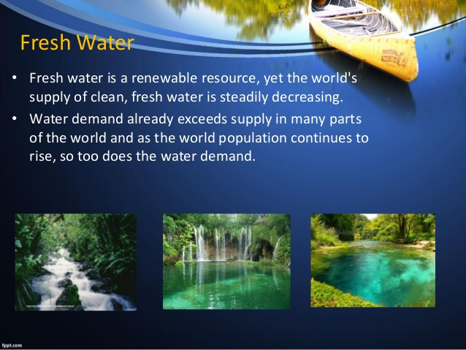

Slide 14
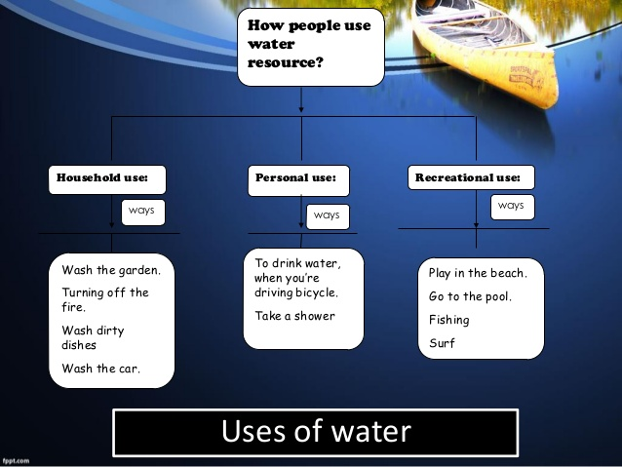

Slide 15
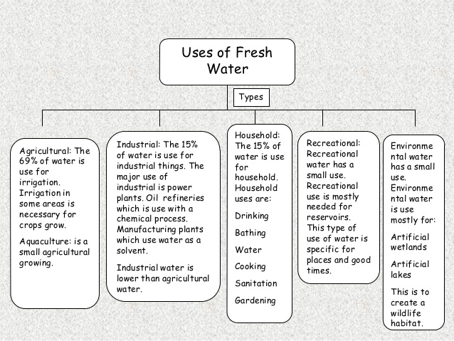

Slide 16
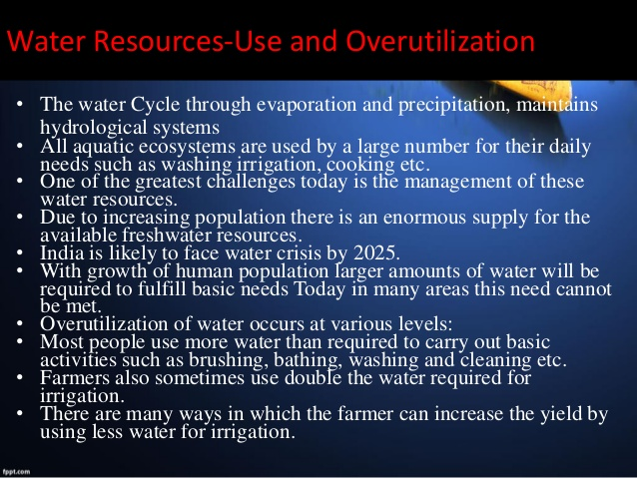

Slide 17
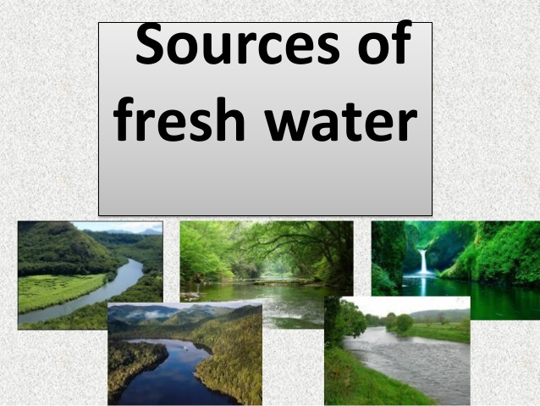

Slide 18
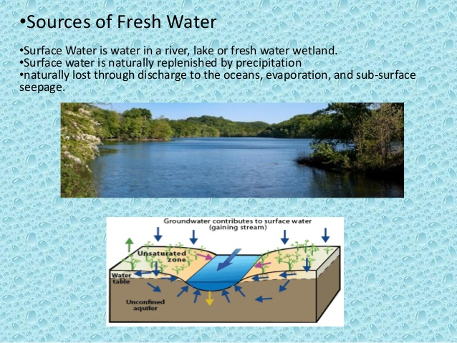

Slide 19
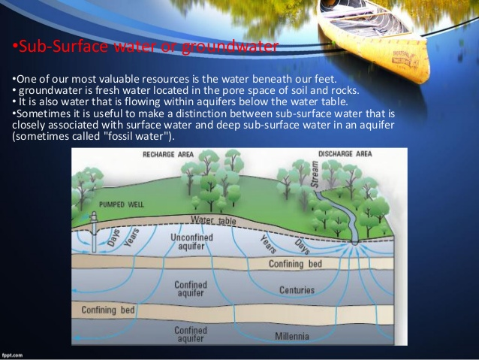

Slide 20
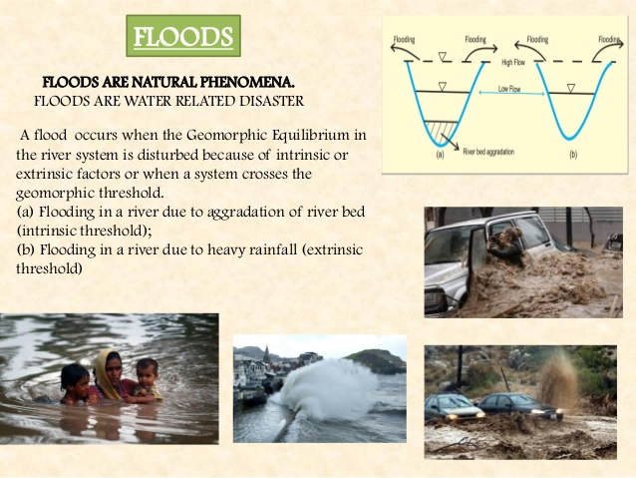
Floods

Slide 21
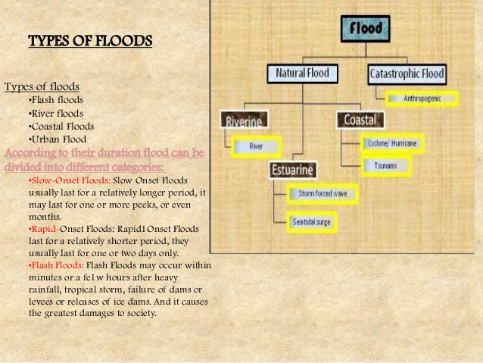
Types

Slide 22
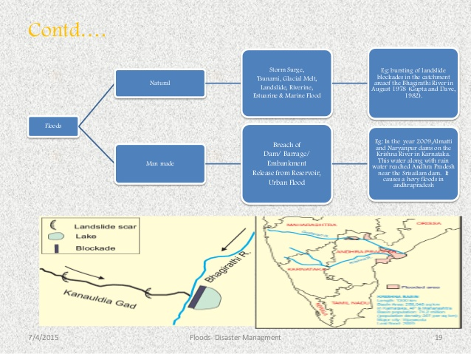

Slide 23
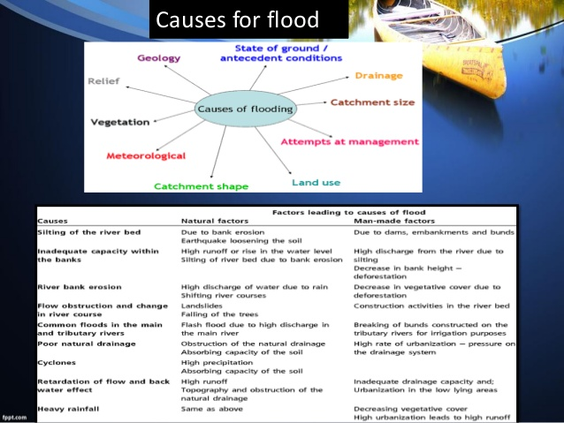
causes

Slide 24
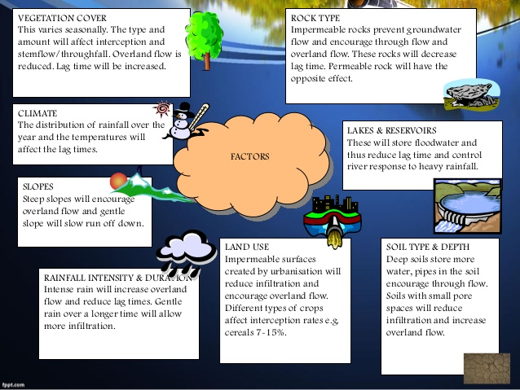

Slide 25
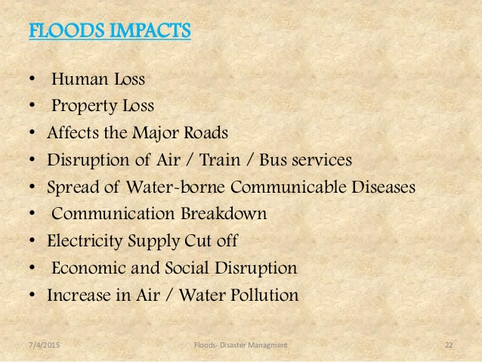
Impacts

Slide 26
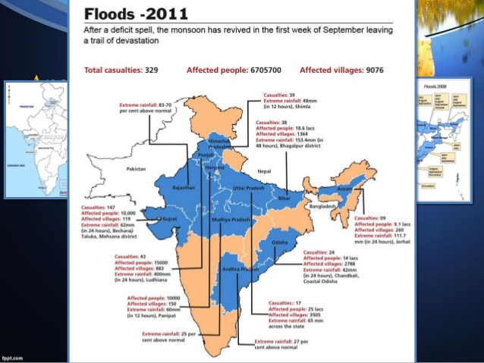

Slide 27
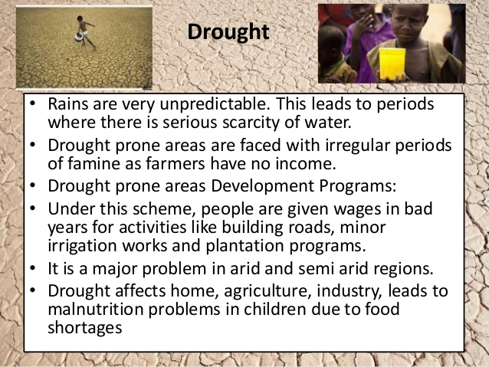
Drought

Slide 28
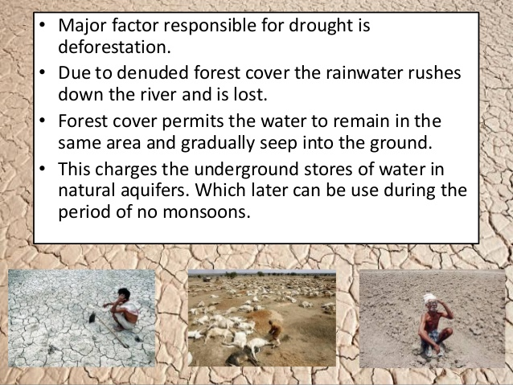

Slide 29
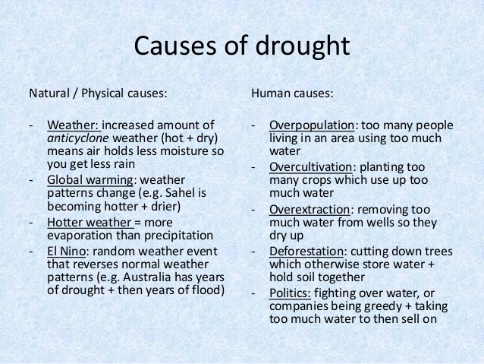

Slide 30
